Slide 1
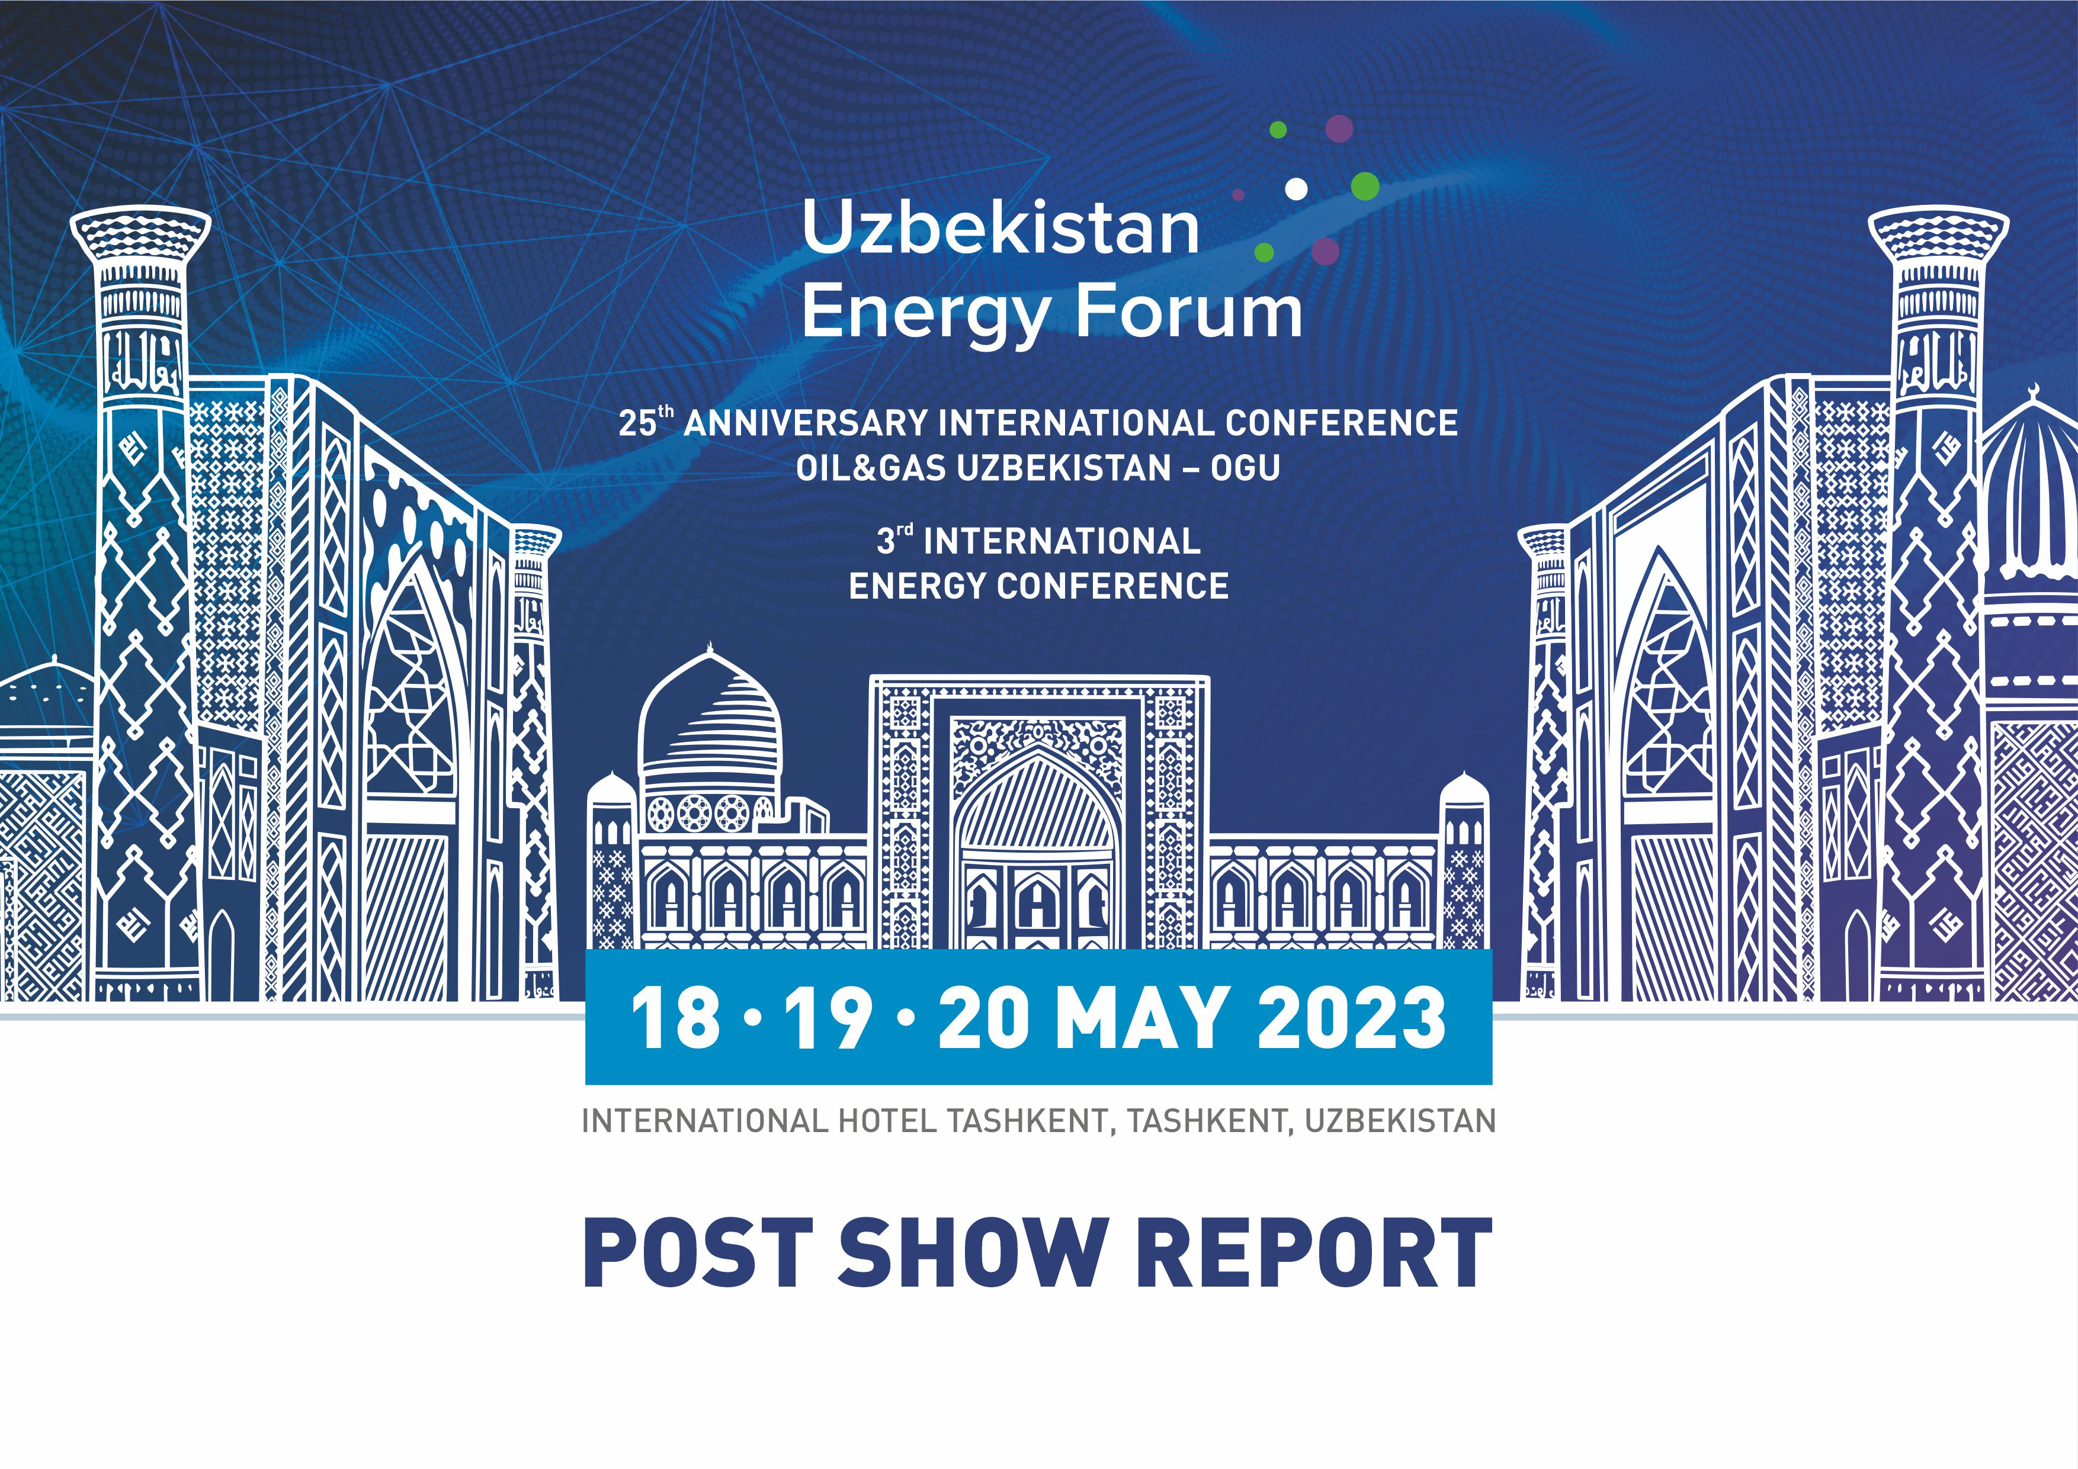

Slide 2

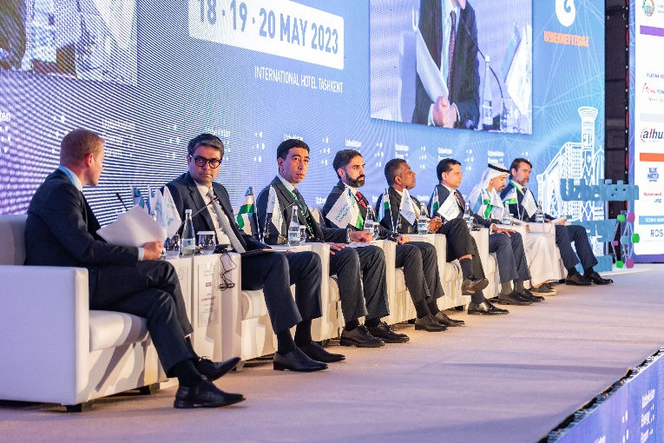
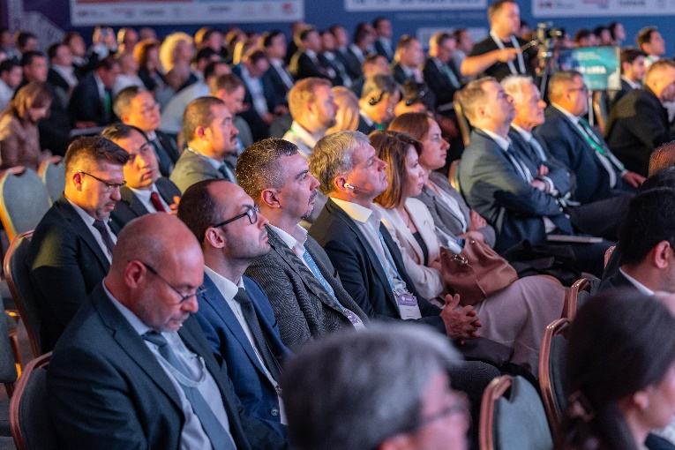
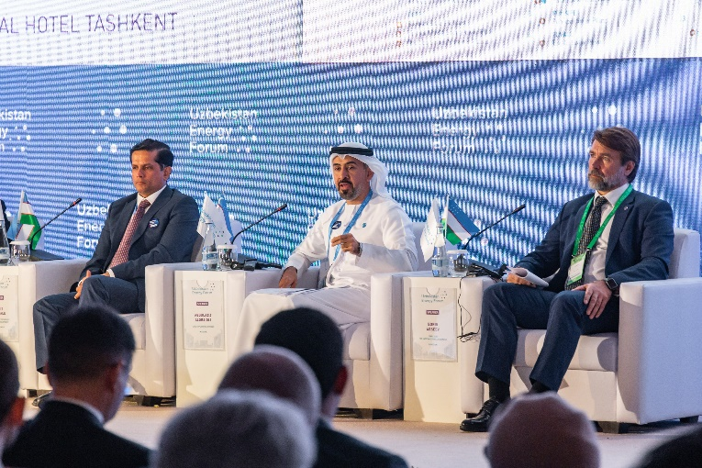
OPENING CEREMONY
OF THE FORUM
VIP speakers and guests of the forum:
Azim Akhmedkhadjaev, First Deputy Minister, Ministry of Energy of the Republic of Uzbekistan
Bakhodirjon Sidikov, Chairman of the Board, “Uzbekneftegaz” JSC
Rovshan Najaf, President, SOCAR
Binu Parthan, Deputy Director, Country Engagement, Country Engagement and Partnerships (CEP) Division, International Renewable Energy Agency (IRENA)
Rohit Gokhale, Executive Vice President - Business Development, Acwa Power
Abdulaziz Alobaidli, Chief Operating Officer, Masdar
Boris Arseev, Director for International Business, ROSATOM
Uzbekistan Energy Forum - is the country’s flagship event that covers all the key sectors of fuel and energy complex to do business and exchange information, attracting top companies, ministries, global CEOs and leading decision makers to shape the future of Uzbekistan’s energy industry.

Slide 3
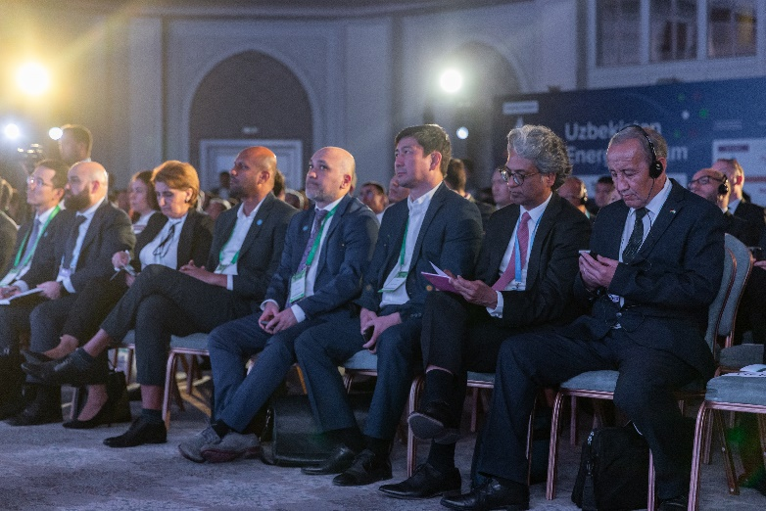
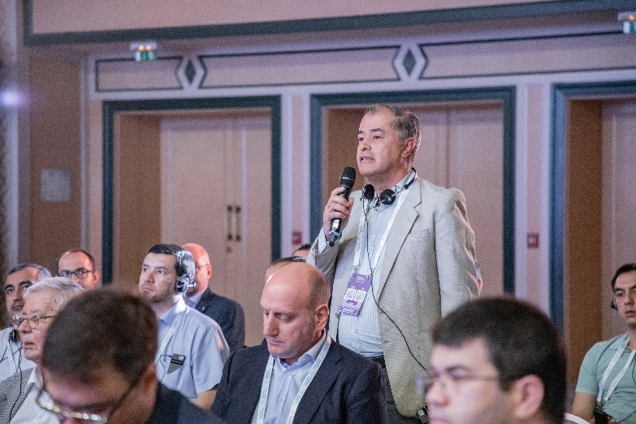
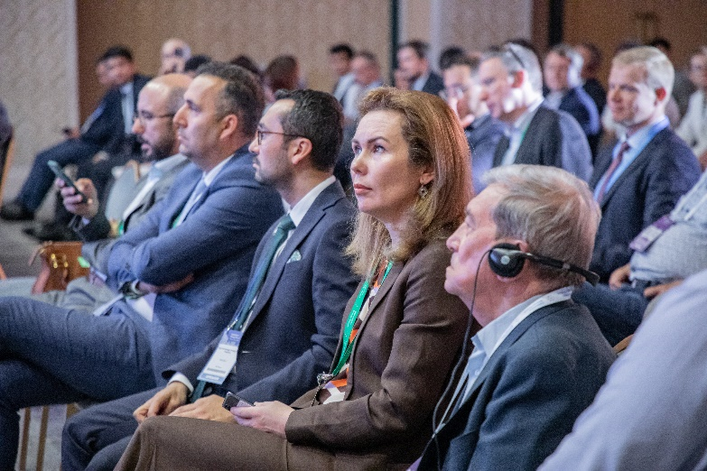
MORE THAN
1 000 DELEGATES
KEY TOPICS:
Strategic planning of the fuel and energy complex of Uzbekistan in the context of dynamic geopolitical and geo-economic realities
Megatrends of the new cycle of development and diversification of the petrochemical industry
Ecological aspects of the energy industry
Modern technologies for forecasting and searching for new hydrocarbon deposits
Optimization of field and production processes in the oil and gas industry integrating with smart technologies
Advanced mechanisms for the introduction of renewable energy and energy efficiency in the energy infrastructure of Uzbekistan
Advanced technological and financial mechanisms for implementation in the energy infrastructure of Uzbekistan
The implementation of nuclear energy - is the basis for ensuring carbon neutrality
Structural transformation as a basis for expanding the innovative ecosystem of the electric power industry of Uzbekistan
Hydrogen energy. Prospects, trends and technological challenges

Slide 4
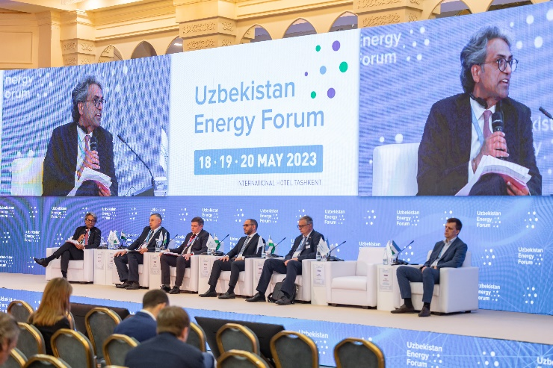
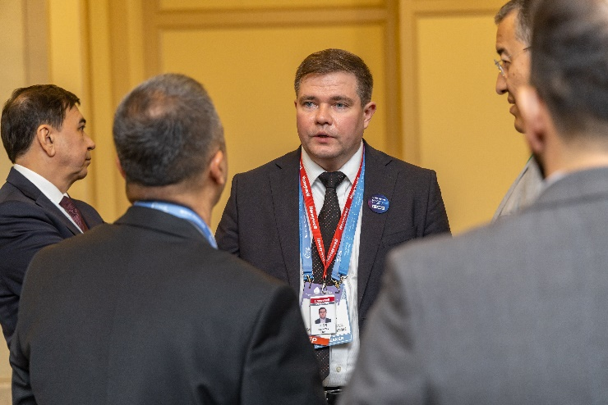
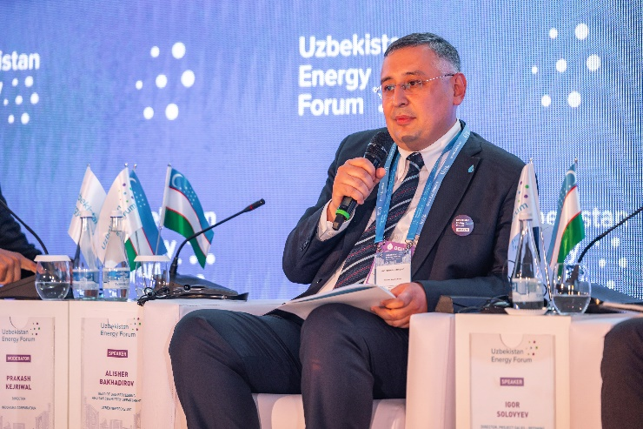
50 SPEAKERS
Delegates: 1000
Sessions: 10
Speakers: 50
Countries: 24
SPEAKERS:
Vitaliy Yakovlev, Managing Partner, KPMG Azerbaijan, and Head of Energy Department, KPMG Caucasus and Central Asia
Prakash Kejriwal, Director, Indorama Corporation
Alisher Bakhadirov, Head of Gas Processing and Gas Chemistry Department, Uzbekneftegaz JSC
Sergey Bulavinov, Head of Moscow Branch, BORSIG GmbH
Igor Solovyev, Director, Project Sales - Refining, Petrochemicals and Gas Processing – Europe, Africa, Turkey, Israel, Central Asia (EATCA), Honeywell
Yassir Ghiyati, Global Vice President and Managing Director, Central Asia & EMEA, Haldor Topsoe
Igor Kurguzov, Head of Sales, European Metallurgical Company
Igor Evstratov, Chief Architect of Production Programs and Digital Solutions, Terralink Technologies
Tatiana Miroshnichenko, Senior Manager, EY
Alisher Mustafaev, Advisor to the Chairman of the Board on health and safety, ESG and sustainable development, Uzbekneftegaz JSC
Alexander Ustyuzhanin, Sales Leader, Baker Hughes
Boris Nikolaev, Chief Business Consultant, Aspen Technology Inc.
Yernar Akhmettaev, Senior Research Analyst, Eurasian Energy, S&P Global
Polina Lion, Director, Sustainable Development Department, Rosatom State Corporation
Anvar Gadoev, Head, Geology Department, Uzbekneftegaz JSC
Nodir Muhutdinov, Minister’s Advisor, Ministry of Mining Industry and Geology of the Republic of Uzbekistan
Diana Shigapova, Strategic Planning Director, Aspen Technology Inc.
Shokhrukh Shomurodov, Team lead in the Department of Geology, Uzbekneftegaz JSC
Ravshan Gulyamov, Deputy Head, Field Operations Department, Head, Modelling Department, Uzbekneftegaz JSC

Slide 5
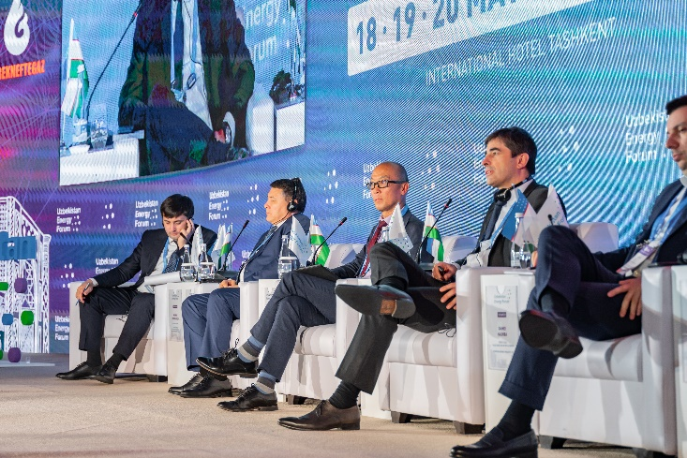
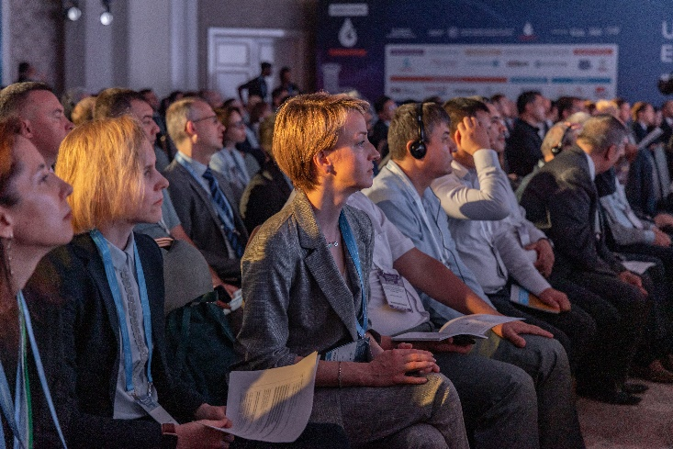
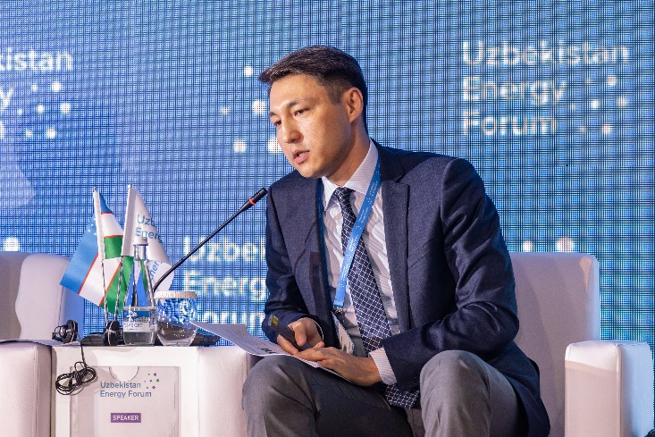
50 SPEAKERS
Delegates: 1000
Sessions: 10
Speakers: 50
Countries: 24
SPEAKERS:
Gaffar Mirzoev, Head of Business Field, Integrity Solutions, Sector CIS and CE, Rosen Group
Mikhail Smirnov, President, Association of Innovative Enterprises in Energy Sector "EnergoInnovation“
Alexey Sachik, Director, LMP Project Group CA, LLC
Farrukh Latipov, Business Development Manager, Dahua Vision
George Kekelidze, The European Association for Renewable Energy EUROSOLAR
Abdulla Otaboev, Director of Energy Efficiency Department, Ministry of Energy of the Republic of Uzbekistan
Binu Parthan, Deputy Director, Country Engagement, Country Engagement and Partnerships (CEP) Division, International Renewable Energy Agency (IRENA)
Shahlo Turdikulova, Deputy Minister of Higher Education, Science And Innovations Of The Republic Of Uzbekistan
Amit Beriya, Executive Director, Technical Services for Project Development, Acwa Power
Abdulla Zayed, Head, Development & Investment (Central Asia & Russia), Masdar
Nahla Abid, Vice President, Sales & Strategy, Middle East and Caspian Sea Region, Bureau Veritas
Baris Arici, R&D Manager, Yeo Technology Energy&Industry
Rafał Kowalewski, Head of Service & Support, Photomate
Rishat Zabbarov, Head of Representative Office in Uzbekistan, Unigreen Energy
Marina Kudriavtceva, General Director, PcVue CIS
Viacheslav Hrechko, Representative in Central Asia, DMCC
Shavkat Abdukamilov, Executive Director, Tashkent Branch of the National Research Nuclear University, MEPhI
Bahrom Mansurov, First Deputy General Director, Uzatom Agency
King Lee, Director Harmony Programme, World Nuclear Association (WNA)

Slide 6
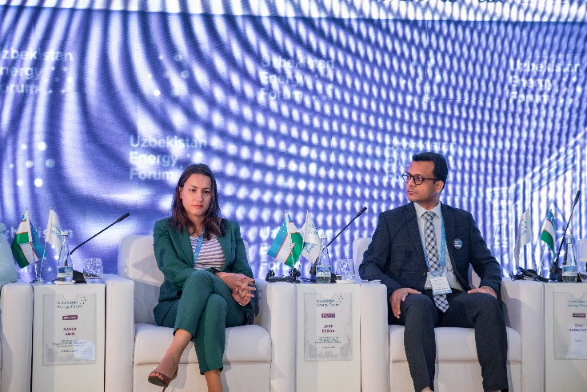
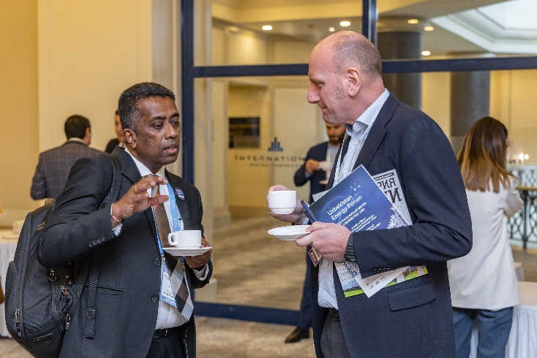
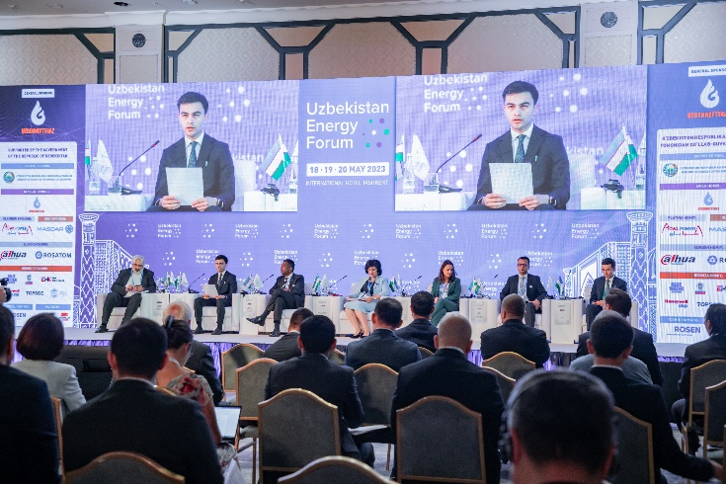
50 SPEAKERS
Delegates: 1000
Sessions: 10
Speakers: 50
Countries: 24
SPEAKERS:
Farrukh Tashmetov, Deputy General Director, Uzatom Agency
Puravet Guillaume, Vice President for International Energy Construction, Assystem
Andrey Rozhdestvin, General Director, JSC Rusatom Energy Projects
Damei Hashba, Deputy CEO, Sales Director in the CA region, Rusatom Energy Projects JSC
Aziz Alimukhammedov, Director, RES Institute under the Ministry of Energy of the Republic of Uzbekistan
Andrey Reznikov, Director for Middle East and North Africa, INGC LLC
German Teplovodskiy, Head of Representative Office, MWM Austria GmbH
Aleksey Koshelap, Head of Service Delivery in Central Asia, TerraLink
Denis Kuznetsov, Business Development Director, MIDDLE EAST POWER SOLUTIONS LLC
Kholisakhon Nuriddinova, Senior Specialist, EY
Olga Beloglazova, Associate Director / Energy Center Leader in Central, Eastern and Southeastern Europe & Central Asia, E&Y, Azerbaijan

Slide 7
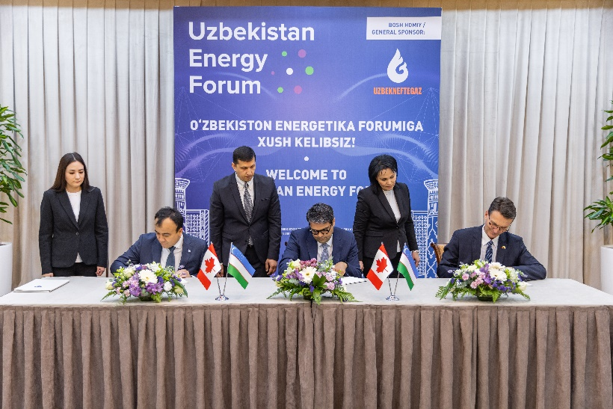
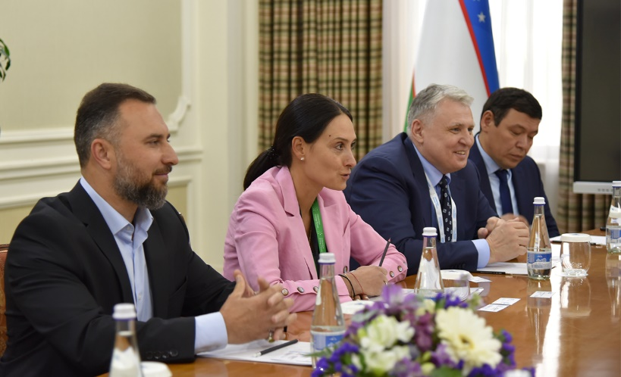
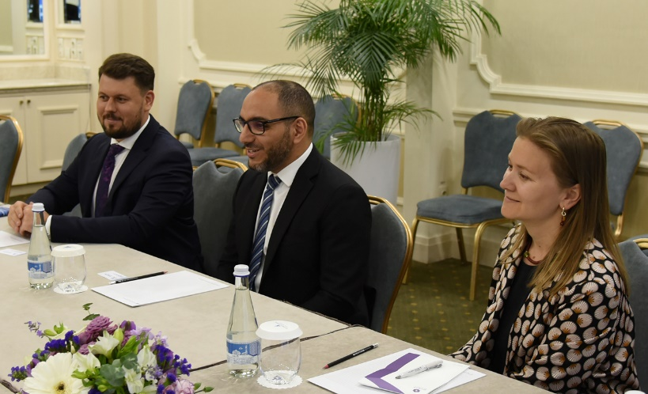
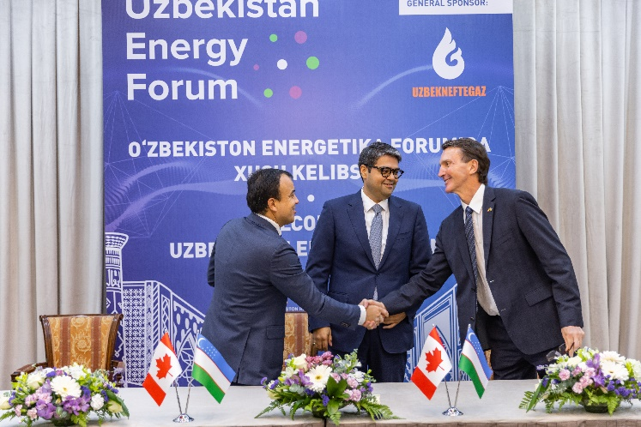
B2G & B2B
MEETINGS
More than 70 business meetings
Holding B2G/В2В meetings and signing bilateral documents at the management level of the Ministry of Energy of the Republic of Uzbekistan and its subsidiaries with world’s leading companies as the Forum’s key unique event contributing to its higher effectiveness

Slide 8
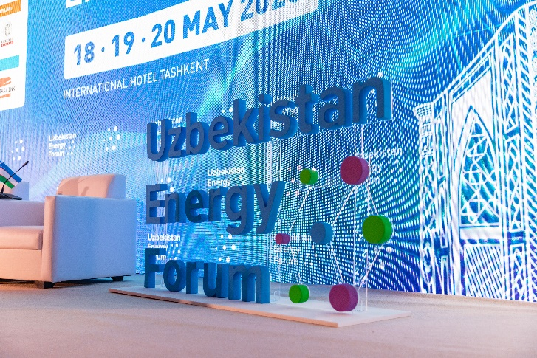
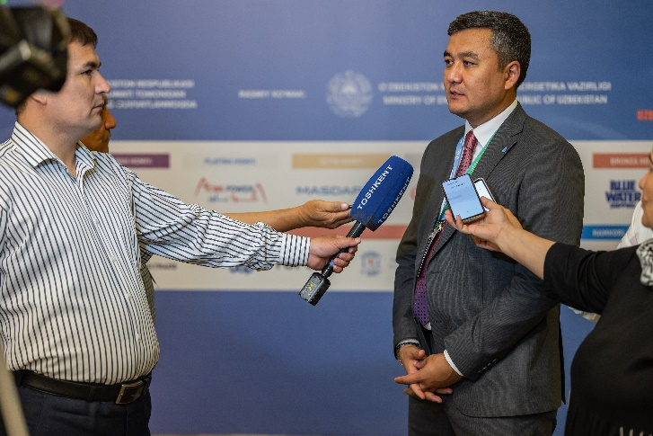
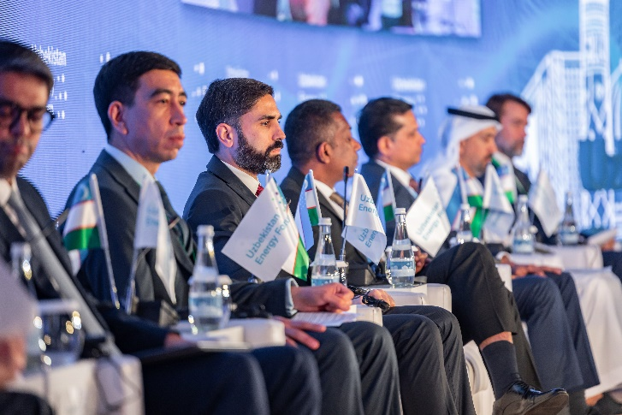
MEDIA ABOUT US
Uzbekistan 24 https://drive.google.com/file/d/1OiAdKgTnaPYqt7AsH5NXgQy7oayrT4G9/view?usp=sharing
YUZ.uz https://yuz.uz/ru/news/v-tashkente-proydet-vtoroy-mejdunarodny-energeticheskiy-forum-uzbekistana
NUZ.uz https://nuz.uz/ekonomika-i-finansy/1276419-v-koncze-maya-v-stolicze-projdet-2-j-mezhdunarodnyj-energeticheskij-forum-uzbekistana.html
Sputnik Uzbekistan https://t.me/sputnikuzbekistan/34394
Dunyo AA. O`zbekiston
https://dunyo.info/cyrl/site/inner/18-20_may_kunlari_ozbekiston_ikkinchi_halqaro_energetika_forumi_bolib_otadi-JL6
Tashkent City administration, Telegram chanel https://t.me/poytaxt_uz/26020
Xalq so’zi/ People's word https://xs.uz/uzkr/97575
Sputnik Uzbekistan https://sputniknews.uz/20230518/ozbekiston-neft-gaz-homiy-kompaniya-35065010.html
Newspaper (printed edition) Xalq so’zi/ People's word № 102 (8445) 19 May 2023
UzDaily сайт https://www.uzdaily.uz/en/post/81041
UzDaily https://www.uzdaily.uz/en/post/81082, https://t.me/UZDAILY/47319
UzDaily тг https://t.me/UZDAILY/47268
YUZ.uz сайт https://yuz.uz/ru/news/mirove-ekspert-obmenivayutsya-optom-na-tretem-mejdunarodnom-energeticheskom-forume-uzbekistana
YUZ.uz тг https://t.me/pvouz/38715
NUZ.uz https://nuz.uz/nauka-i-tehnika/1277930-zelenye-i-otvetstvennye.html
UZA.uz https://uza.uz/ru/posts/energeticheskiy-forum-budet-sluzhit-razvitiyu-neftegazovoy-i-energeticheskoy-otrasley-nashey-strany_485608
UZA.uz https://uza.uz/uz/posts/ekspertlar-neft-gaz-va-energetika-tarmogida-hamkorlik-istiqbollarini-muhokama-qildi_484755
UZA.uz https://uza.uz/uz/posts/manfaatli-sohalar-boyicha-hamkorlik-masalalari-muhokama-qilindi_484332
Darakchi.uz https://darakchi.uz/uz/166625

Slide 9
















OFFICIAL SUPPORT
GENERAL SPONSOR:
PLATINUM SPONSOR:
GOLD SPONSOR:
SILVER SPONSORS:
BRONZE SPONSORS:
BRANDED SPONSORS AND PARTNERS:

Slide 10
